Slide 1

Analysis and Design Procedure of Sequential Circuits
CSE 4205 Digital Logic Design
Course Teacher: Md. Hamjajul Ashmafee
Lecturer, CSE, IUT
Email: ashmafee@iut-dhaka.edu

Slide 2
Remaining to Add
For Design and Analysis Procedure
Review other books and internet resources
Give 2 hours to make it complete and beautiful
For Pattern/Sequence detector:
Review other books and internet resources
Draw the figure with Wacom (slide 11)

Slide 3
Analysis Procedure From book [Page 250]
Starting with a sequential Circuit
Deriving its state table
2 variants to represent
Deriving its state diagram from the state table
Deriving its state equation from the state table
Final outcome
Also, need to describe the behavior of the circuit [Preferred]
Summarize all generalized steps

Slide 4
Design Procedure From book [Page 254]
Mention all Generalized Steps
Example following those steps

Slide 5
Example of Design Procedure Sequence/Pattern Detector

Slide 6

Sequence/Pattern Detector
A sequential circuit that takes the input of binary bit streams and generate an output true (e.g. logic 1) when the target sequence is detected
Bit stream (1s and 0s) will be fed/inserted as input to check for particular pattern or sequence
As soon as, the target pattern is detected, it will make the output high
As the output depends on the current state as well as the external input (x), a Mealy FSM is considered

Slide 7
Sequence/Pattern Detector: Types
Types:
Overlapping
The last bit of one sequence becomes the intermediate bit of the next sequence
Non-overlapping
The last bit of one sequence doesn’t become the intermediate bit of the next sequence
They will be clear from the examples

Slide 8
Design A Sequence Detector
Steps:
Step 1: Develop the state diagram
Step 2: Perform the state assignment and state reduction
Step 3: Select the number and type of the flip flop
Step 4: Derive Circuit Excitation Table
Step 5: Derive the expressions for input of the flip flops and output(s)
Step 6: Develop the circuit

Slide 9
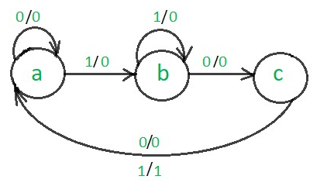
Non-overlapping ‘101’ Mealy Sequence Detector
Example:
State Diagram:
Input : | 0 | 1 | 1 | 0 | 1 | 0 | 1 | 0 | 1 | 1 | 0 | 0 | 1
Output: | 0 | 0 | 0 | 0 | 1 | 0 | 0 | 0 | 1 | 0 | 0 | 0 | 0

Slide 10
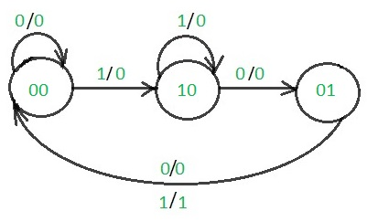
Non-overlapping ‘101’ Mealy SD…
State Assignment:
a | 00 | Nothing detected
b | 10 | ‘1’ detected
c | 01 | ‘10’ detected
Notes:
Review: One hot assignment

Slide 11
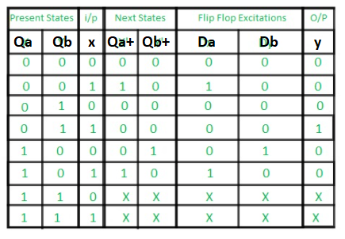
Non-overlapping ‘101’ Mealy SD…
Type and number of flip flops:
Two D flip flops
Circuit Excitation Table:

Slide 12
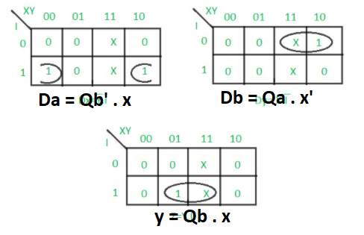
Non-overlapping ‘101’ Mealy SD…
Expression Derivation:

Slide 13
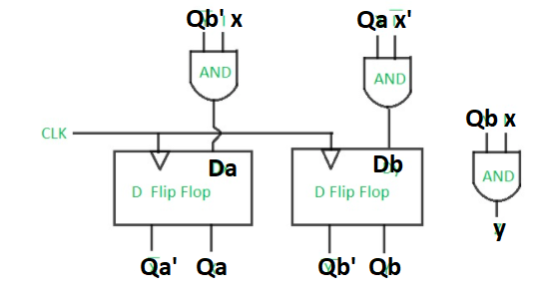
Non-overlapping ‘101’ Mealy SD…
Circuit Implementation:

Slide 14
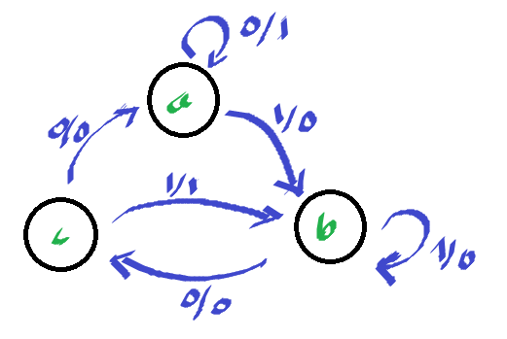
Overlapping 101 Mealy Sequence Detector
Example:
State Diagram:
Input : | 0 | 1 | 1 | 0 | 1 | 0 | 1 | 0 | 1 | 1 | 0 | 0 | 1
Output: | 0 | 0 | 0 | 0 | 1 | 0 | 1 | 0 | 1 | 0 | 0 | 0 | 0

Slide 15
Overlapping 101 Mealy SD…
Others steps would be same as before.

Slide 16
Administration
abc

Slide 17
Administration
abc

Slide 18
Administration
abc

Slide 19
Administration
abc

Slide 20
Administration
abc

Slide 21
Administration
abc

Slide 22
Administration
abc

Slide 23
Motivation
abc
Notes:
Semiconductor: a material having conductivity falling between conductor and insulator. Basis of any IC

